Slide 1

Driver Drowsiness Monitoring System
By:
Thejaswini B S

Slide 2
Introduction
A Driver Drowsiness Monitoring System uses real-time video feed and facial landmark detection to identify signs of driver fatigue and alert them, enhancing road safety. This system leverages computer vision and machine learning techniques to continuously monitor and analyze the driver's eye movements and blinking patterns.

Slide 3
Problem Statement
Driver drowsiness is a significant cause of road accidents, posing a severe risk to driver safety. A system is needed to detect signs of fatigue in real-time and alert the driver to prevent accidents caused by drowsiness.

Slide 4
Pre-Requisite
Before building a Driver Drowsiness Monitoring System, ensure you have a basic understanding of computer vision and machine learning, as well as experience with Python programming and web development using Flask. Additionally, install necessary libraries such as OpenCV, Dlib, Scipy, and Flask, and download the facial landmark predictor model from Dlib's model zoo.

Slide 5
Tools
Python Libraries:
OpenCV
Dlib
Scipy
Flask
2. HTML/CSS/JavaScript:
For the web interface

Slide 6
Advantages of the Proposed Solution
Real-Time Processing: The solution leverages real-time video feed and processing, providing immediate feedback and alerts to the driver.
Cost-Effective: Utilizing open-source libraries and a standard webcam makes the system cost-effective compared to specialized hardware solutions.
Flexibility: The system can be easily customized and enhanced with additional features, such as audio alerts, logging, and integration with vehicle systems.
Web Interface: The use of Flask and a web interface allows for easy access and monitoring via any device with a web browser.

Slide 7
Comparison to Alternatives
Specialized Hardware Solutions: While specialized hardware might offer higher accuracy, it is significantly more expensive and less accessible for general use. Our solution is more accessible and can be implemented with minimal investment.
Non-Real-Time Solutions: Some systems analyze data post-drive, which doesn’t help in preventing accidents. Our system works in real-time to alert drivers instantly.
Single Feature Systems: Some alternatives focus on only one aspect, such as head nodding or eye closure. Our system combines multiple indicators (e.g., blink rate, eye aspect ratio) for more accurate detection.

Slide 8
Adaptation and Improvement Plan
User Feedback: Continuously collect feedback from users to identify areas for improvement and adapt the system to meet their needs more effectively.
Machine Learning Enhancements: Integrate machine learning models to improve accuracy over time by learning from more data.
Scalability: Enhance the system to handle multiple video feeds simultaneously for use in public transport or fleet management.
Mobile Integration: Develop a mobile app version to increase accessibility and provide alerts directly to the driver's phone.
Additional Sensors: Integrate with additional sensors like heart rate monitors or steering patterns to improve detection accuracy.
Compliance and Standards: Ensure the system complies with industry standards and regulations for automotive safety systems.

Slide 9
Building Adaptation
Modular Design: Structure the system with a modular design to allow easy integration of new features and updates.
Extensive Testing: Conduct extensive testing in various conditions to ensure robustness and reliability.
Documentation and Tutorials: Provide comprehensive documentation and tutorials to help users set up and customize the system.
Community Involvement: Foster a community around the project for collaborative improvement and support.

Slide 10
UNIQUEness
Our approach uniquely combines real-time video processing with facial landmark detection using open-source tools to create a cost-effective and flexible driver drowsiness monitoring system. By utilizing a web-based interface, the solution ensures accessibility and ease of use across various devices.

Slide 11
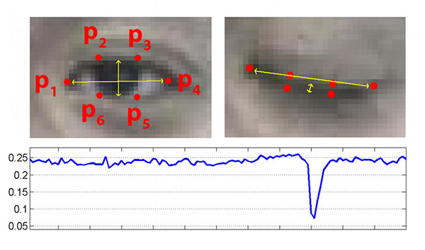
OUTPUT
The eye region is marked by 6 coordinates. These coordinates can be used to find whether the eye is open or closed if the value of EAR is checked with a certain threshold value.

Slide 12
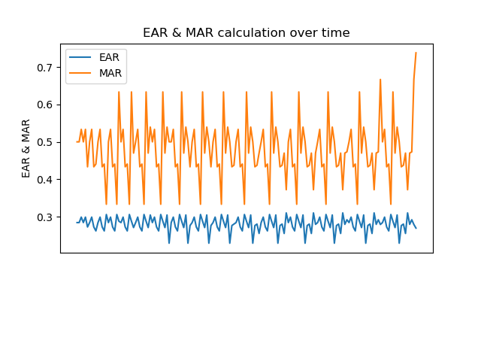
I have tried plotting the MAR and EAR graph Vs. Time in order to make the working clearer to the audience. The graph looks like:

Slide 13
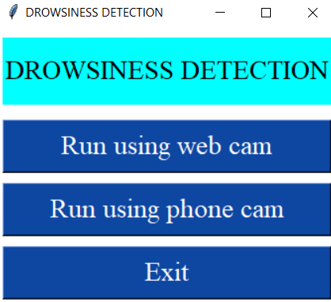
User interface

Slide 14
CONCLUSION
In conclusion, the Driver Drowsiness Monitoring System provides a real-time, cost-effective solution to enhance road safety by detecting driver fatigue using accessible, open-source tools. Its flexibility and ease of use make it a valuable addition to modern vehicular safety systems.

Slide 15
Thank You

